Slide 1
TalentDesire
Future is in your hands

Slide 2
Users Involved
ID | Name
1847141 | Abdulrahman Saeed Al-Suhimi
1944989 | Owis Mohammed Bukhari
1947384 | Mohammed Ahmed Hakami
Adviser: Dr. Khaled Al-Raddah

Slide 3
Table of contents
01
Planning
03
Analysis
02
Understanding
04
Design

Slide 4
01
Planning

Slide 5
Description

Slide 6
Aims

Slide 7
Objectives
Improve
Apply
Establish
+ Quality of learning
+ User Interface Design
+ Time usage
+ Paid/Free Lessons
+ Ease of use
+ Learning Standard
+ Connections
+ Community
+ Opportunities

Slide 8
Project Plan
Problem understanding
Design
Phase 2
Phase 4
Phase 1
Phase 3
Planning
Analysis

Slide 9
Skills & Tools
React Native
Expo
Firebase
Figma

Slide 10
02
Problem Understanding

Slide 11
Stakeholders
University Of Jeddah
Students
Facility Members
Firebase
Talented Members
UJ Active Directory

Slide 12
How to identify the problem?
Discuss
Research
Study
Implement

Slide 13
- Project domain
“TalentDesire is aimed for students as an Educational, Financial, Beneficial tool/program to help with educational matters.”

Slide 14
Comparative review
SkillShare
Plurasight

Slide 15
Gaps in Available Research
Meeting | In person | Online
Development | Develop skills | No practice
Exclusivity | UJ students | Common students

Slide 16
03
Analysis

Slide 17
Requirement

Slide 18
Functional
Create account
Login
Apply
Schedule
Chat availability
Request service

Slide 19
Functional
Privacy
Create a course
Create a service
Requests

Slide 20
Non-Functional
Performance
Scalability
Portability
Compatibility
Reliability
Availability

Slide 21
Non-Functional
Maintainability
Security
Localization
Usability

Slide 22
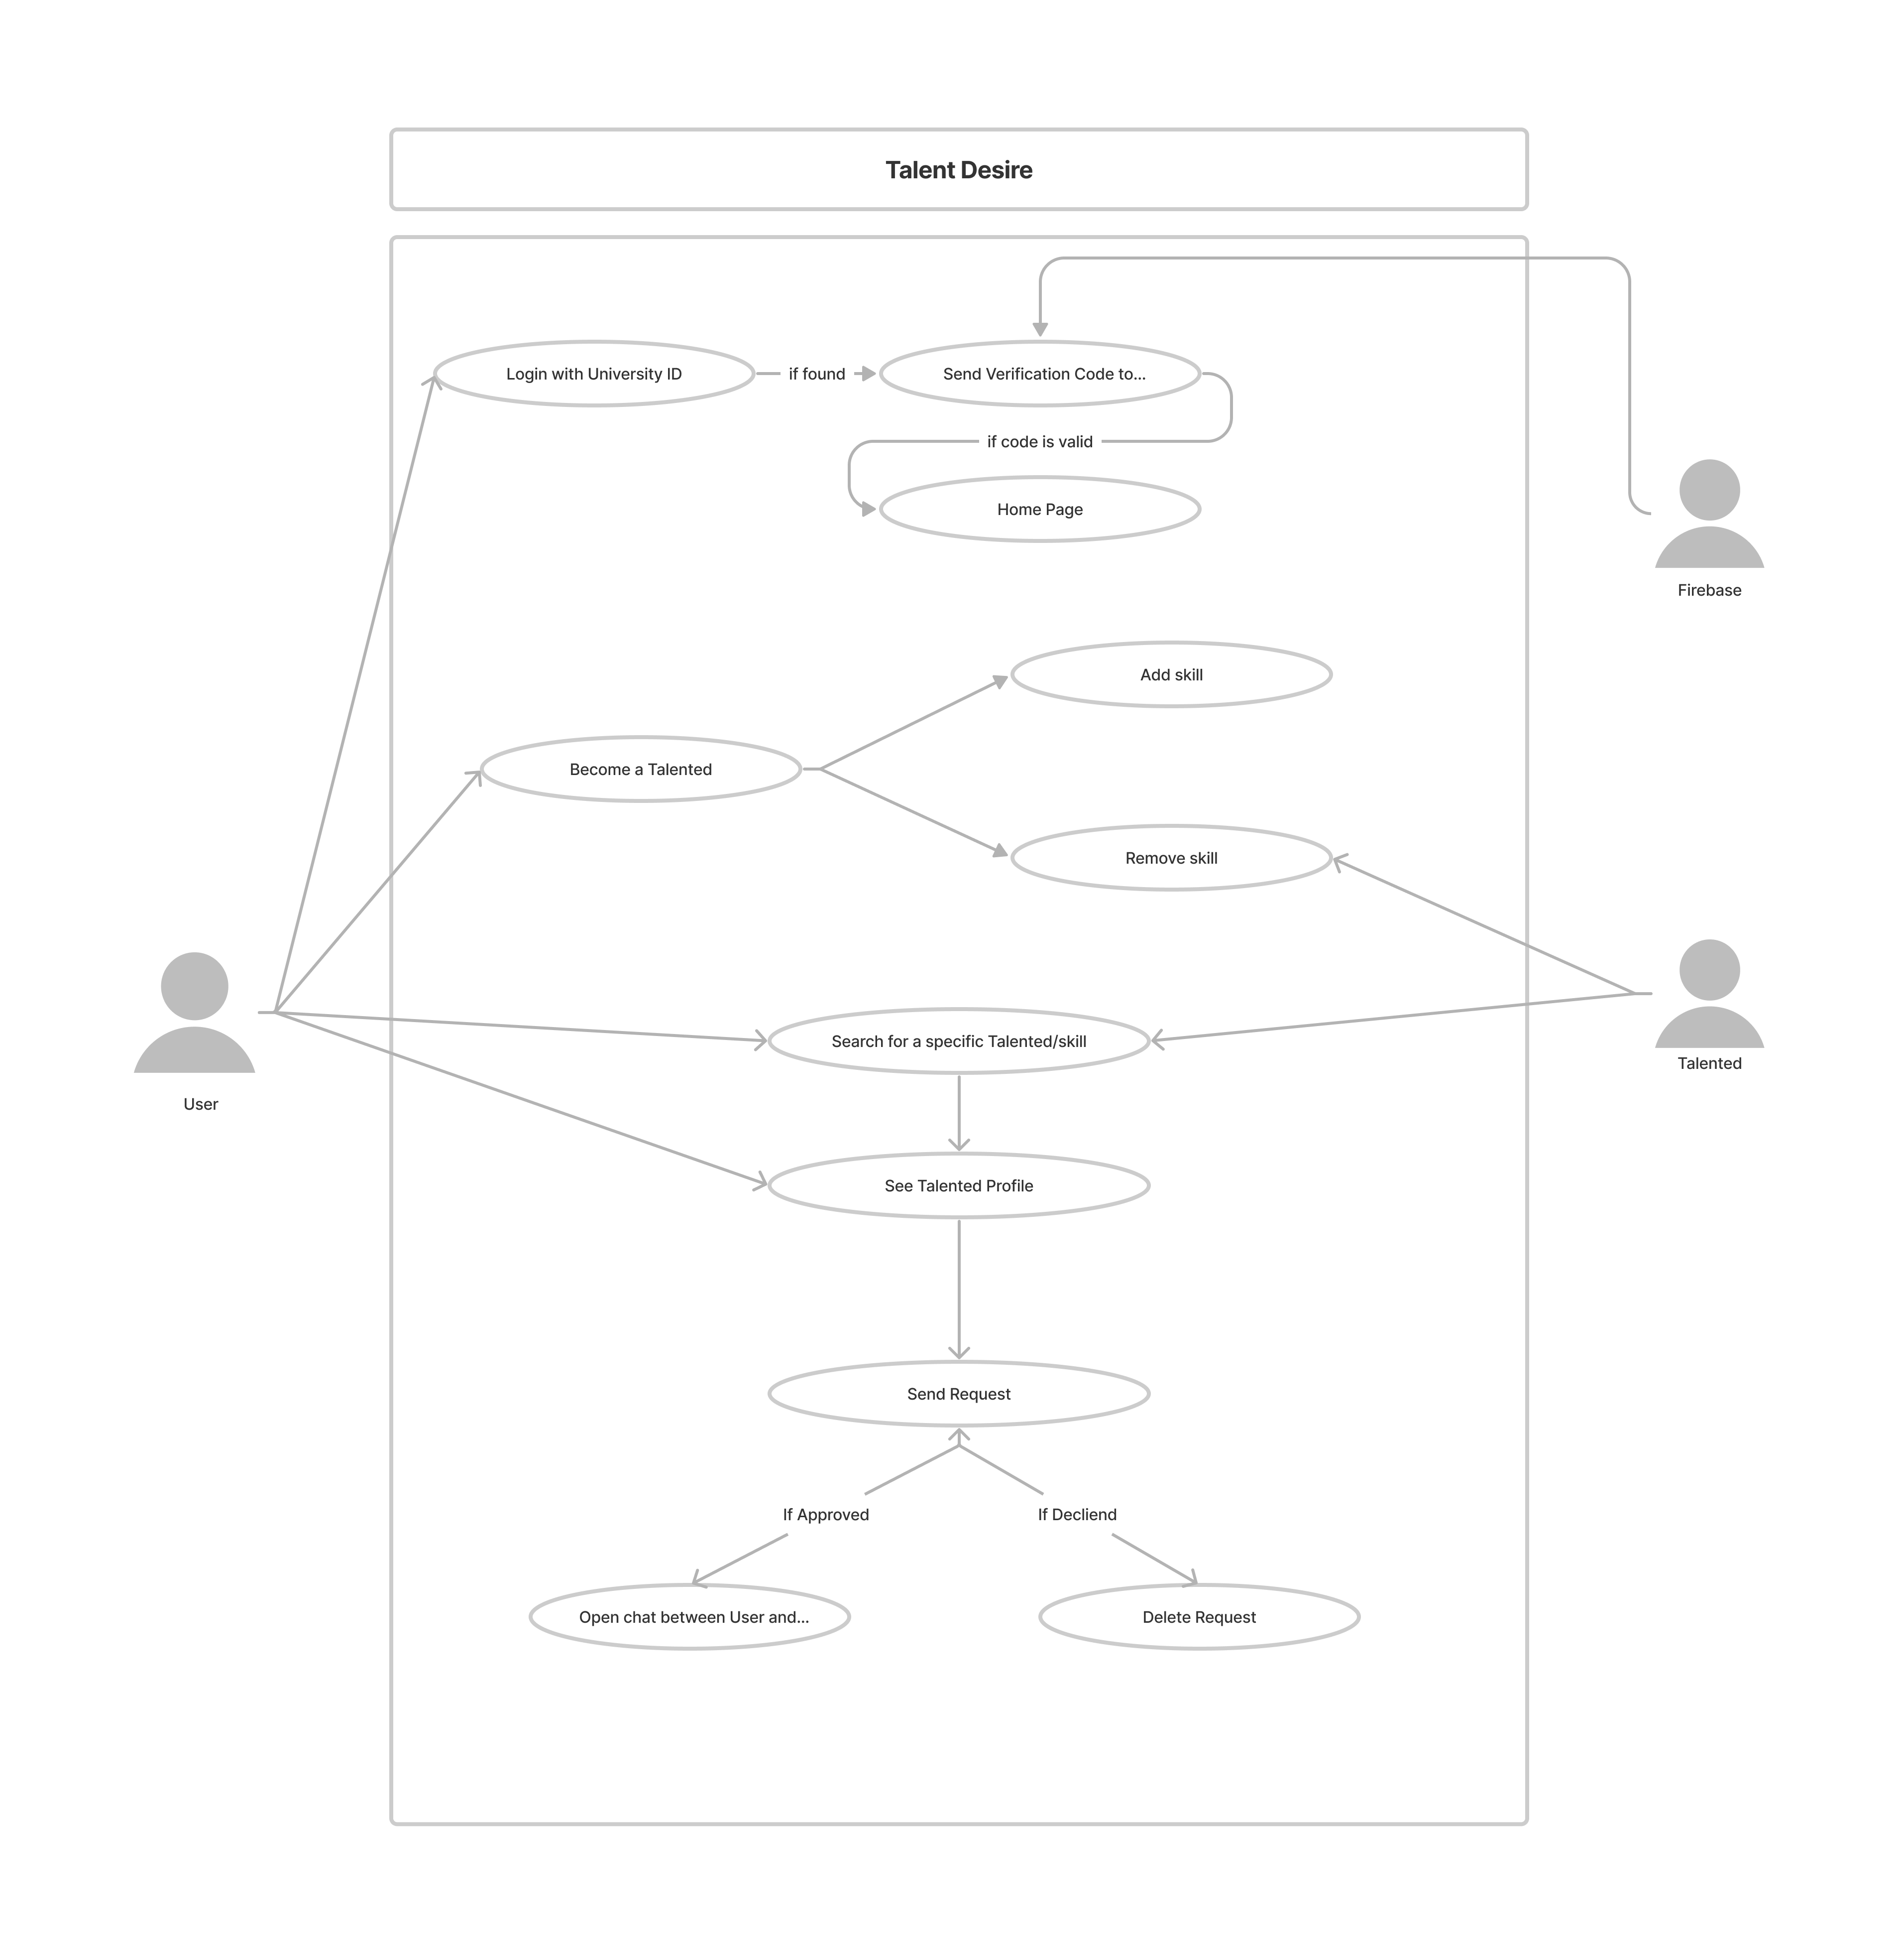
Detailed Use Case Diagram

Slide 23
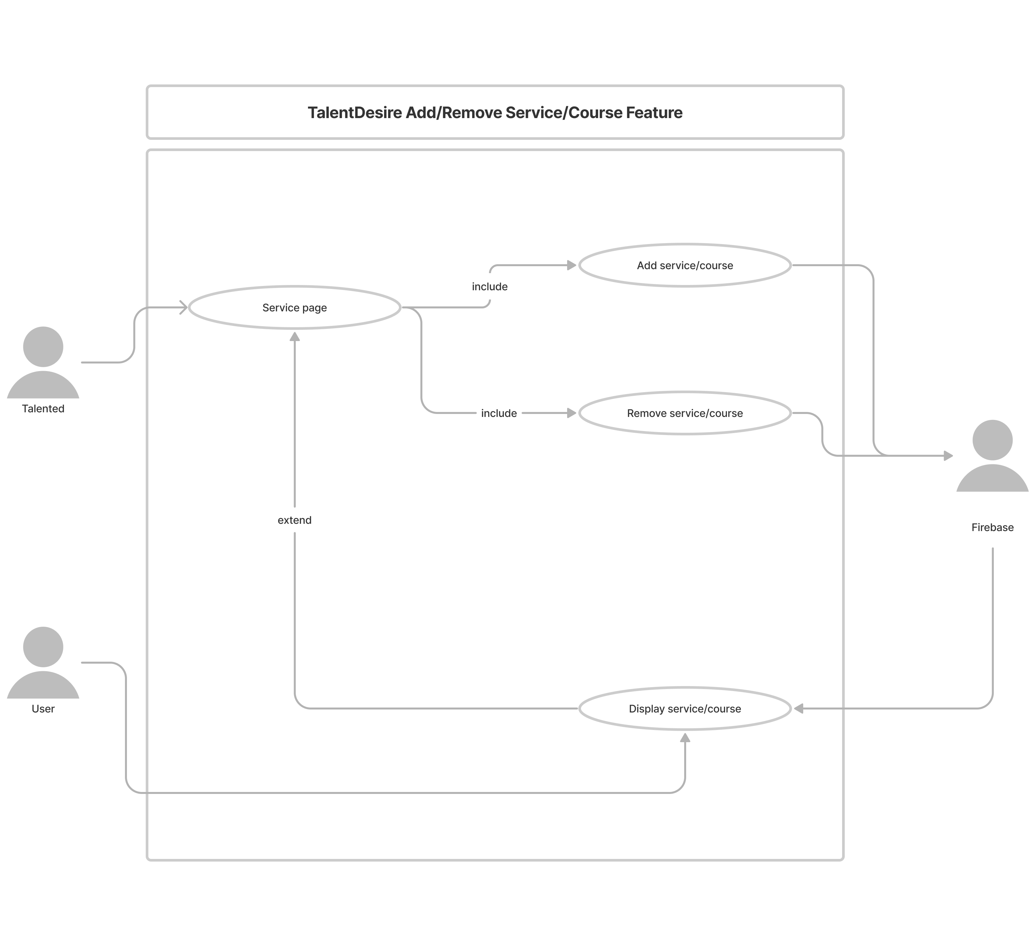
Add/Remove Service or Course

Slide 24
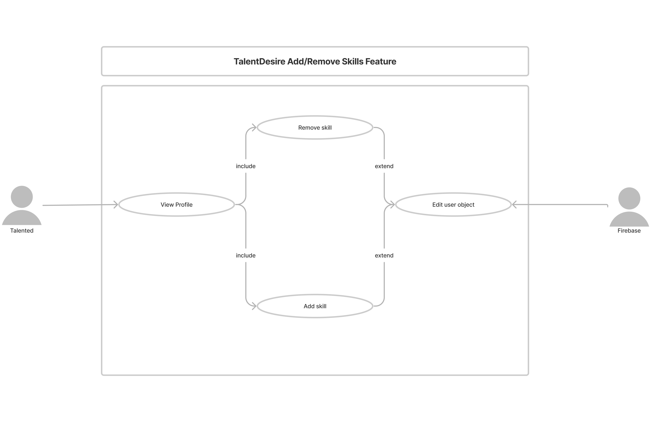
Add/Remove Skill

Slide 25
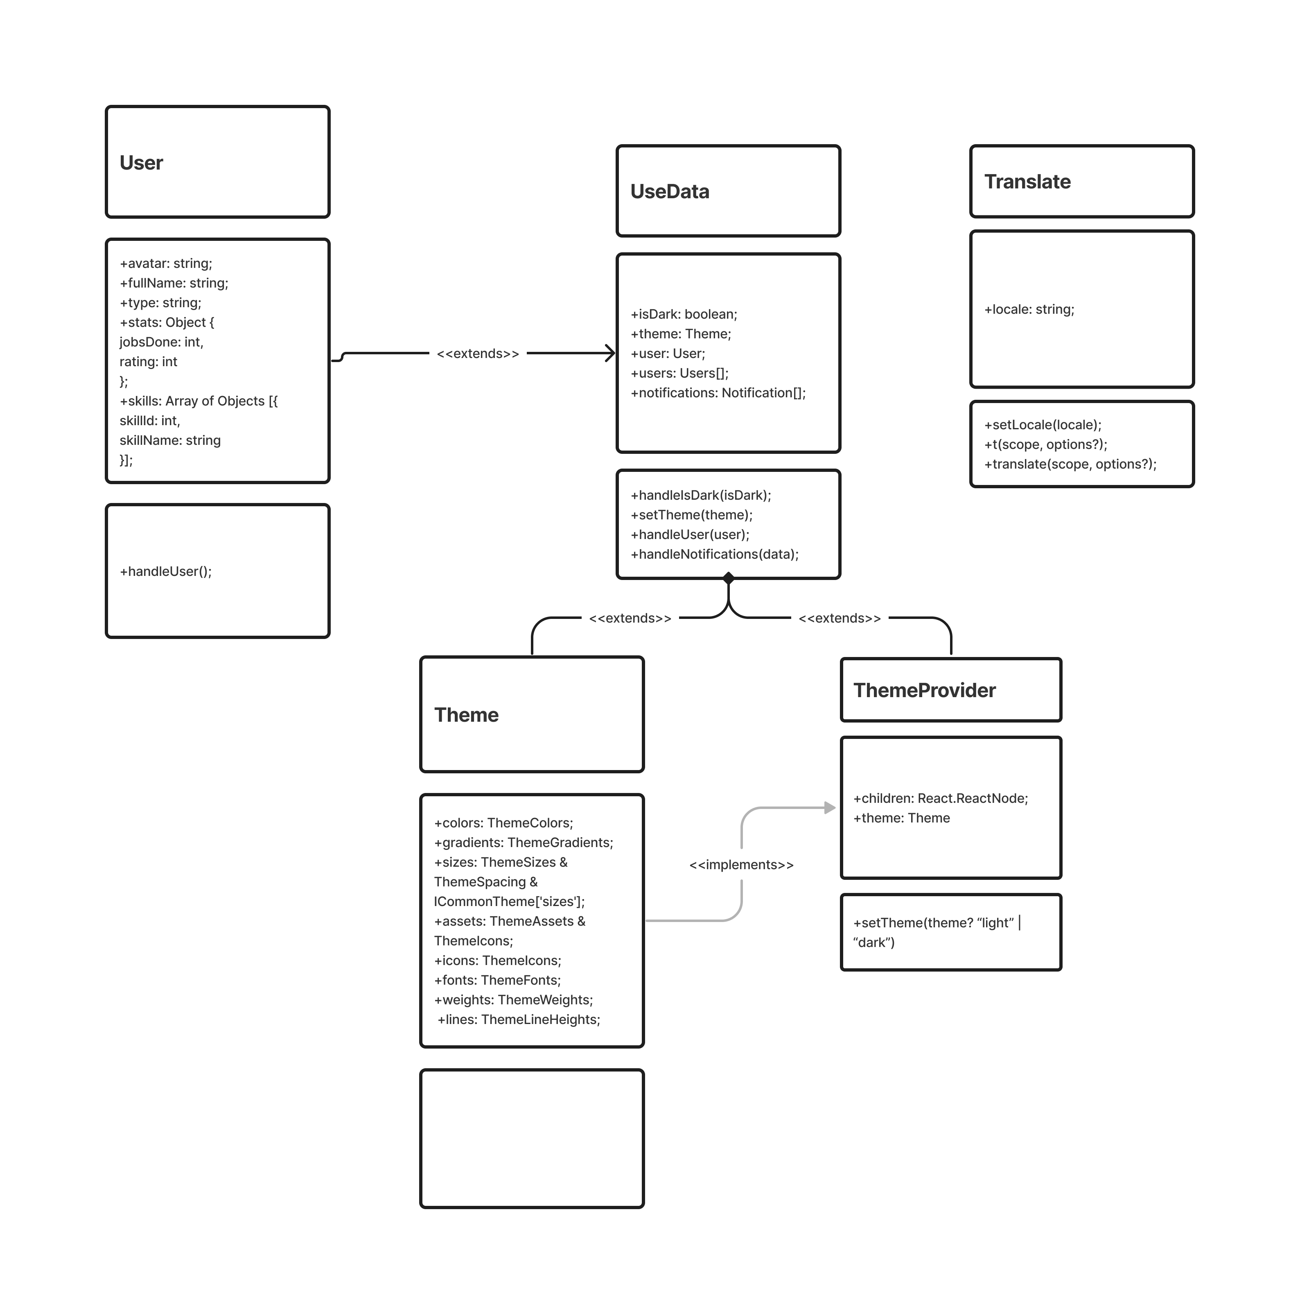
Simple Class Diagram

Slide 26
Detailed Class Diagram

Slide 27
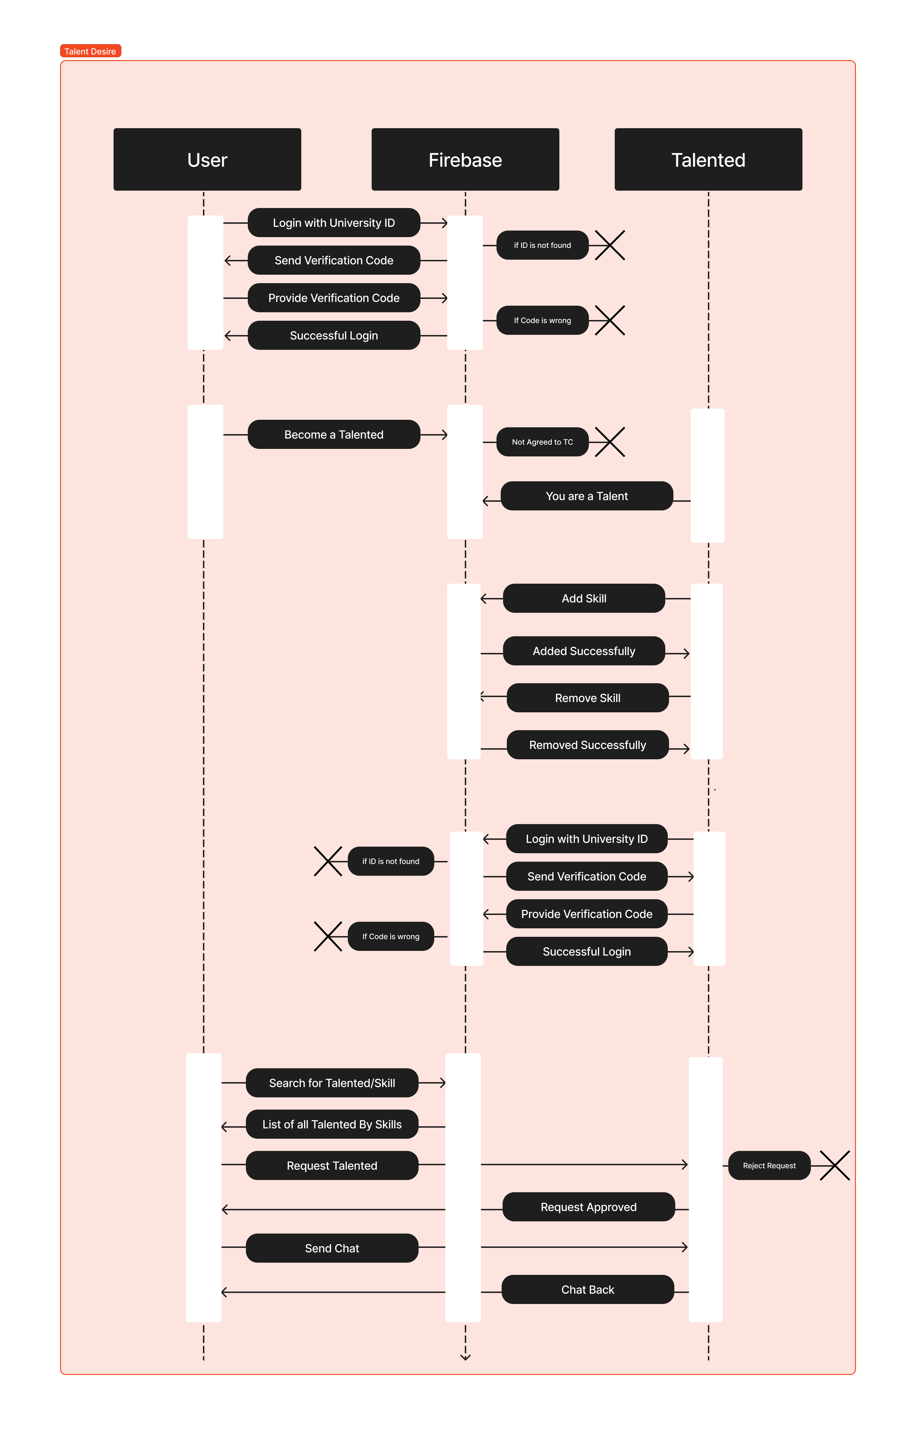
Sequence Diagram

Slide 28
Survey

Slide 29

Flyer

Slide 30
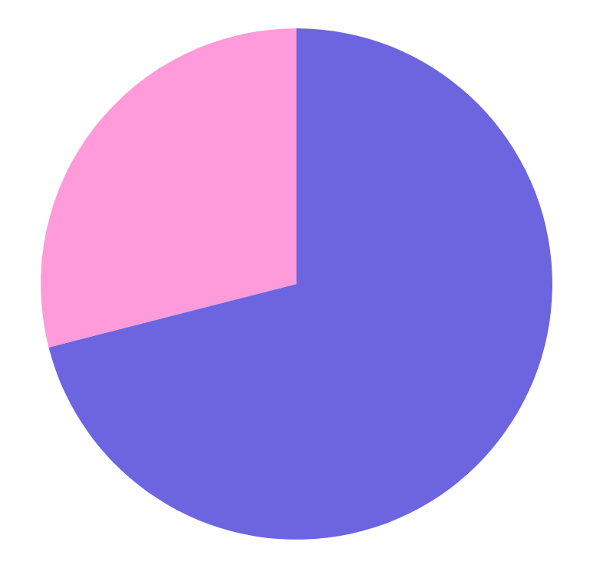
Are there varieties of platform for displaying my skills?
71%
Yes
29%
NO

Slide 31
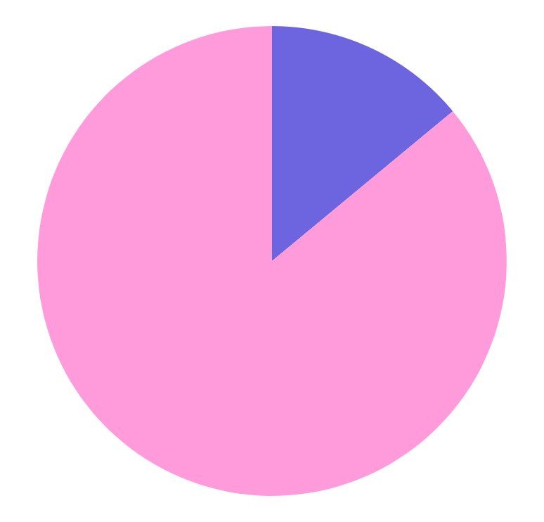
Can I easily find help?
14%
Yes
86%
NO

Slide 32
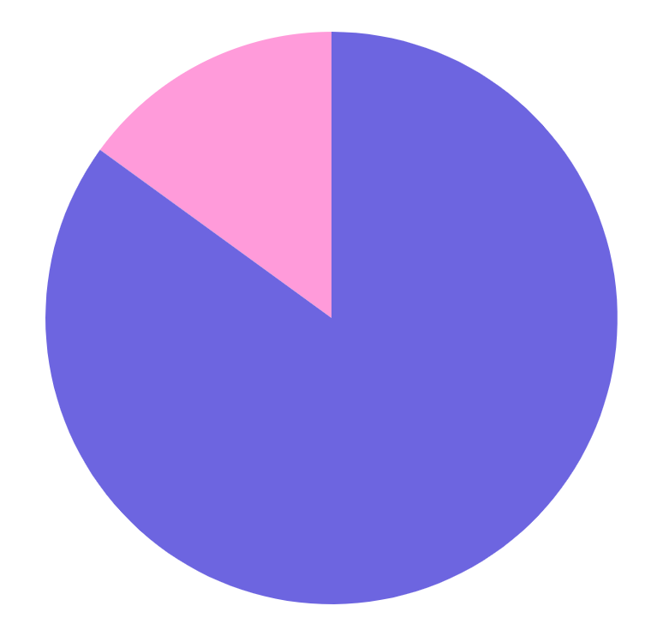
Do you have difficulties finding knowledge?
85%
Yes
15%
NO

Slide 33
04
Design

Slide 34
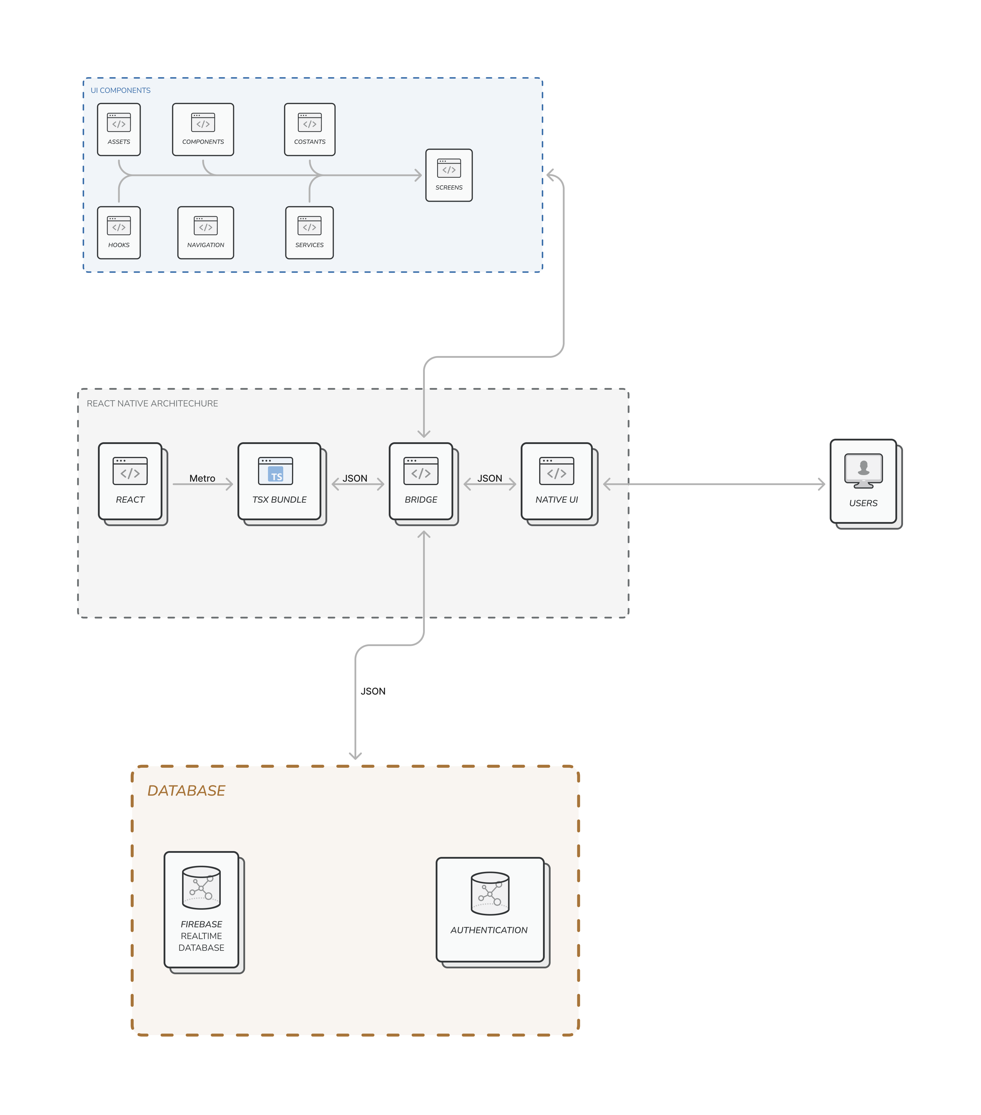
System architecture

Slide 35
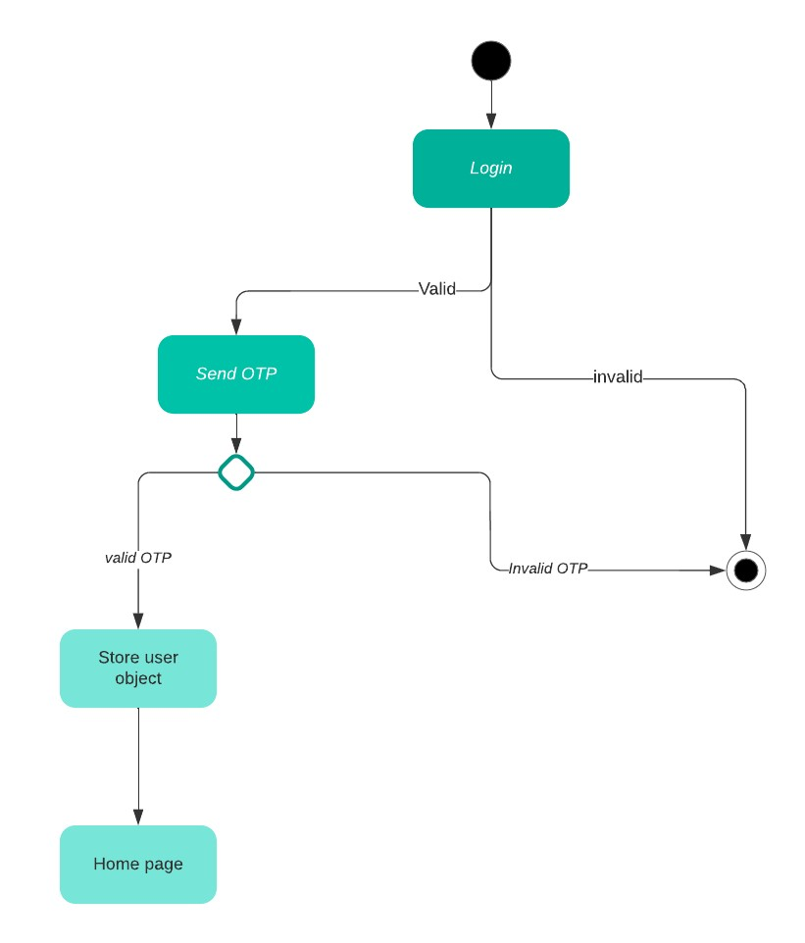
Login state diagram

Slide 36
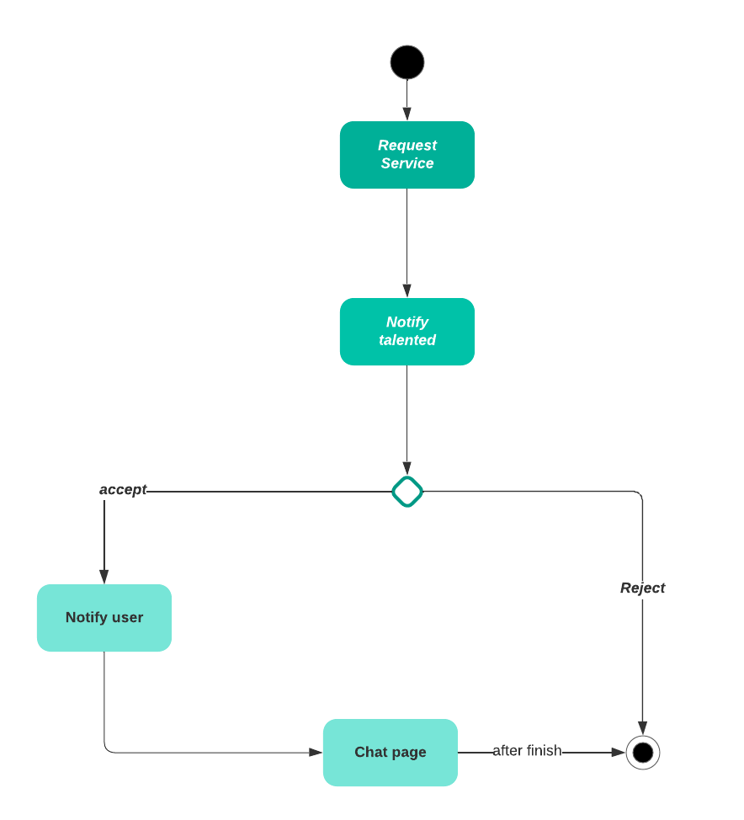
Request state diagram

Slide 37
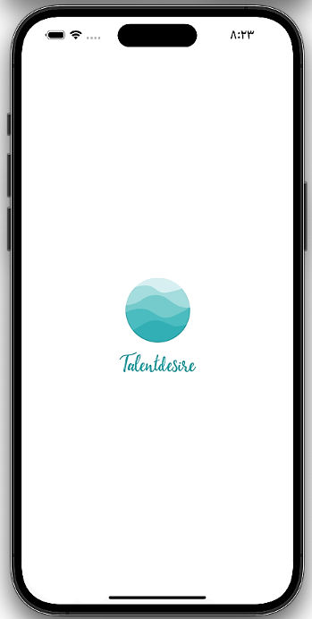
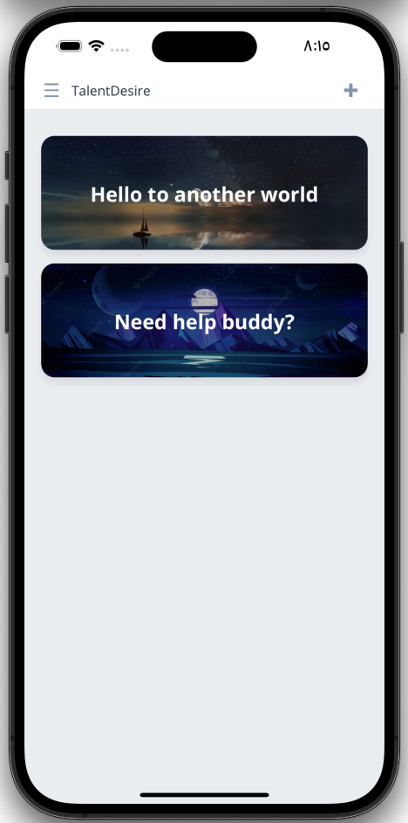
Splash screen & Home page

Slide 38
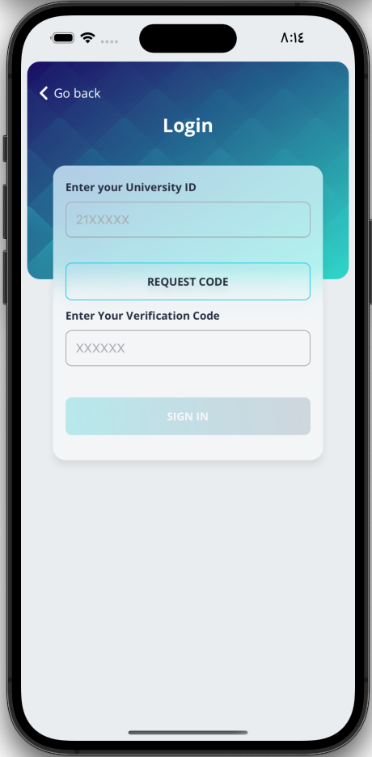
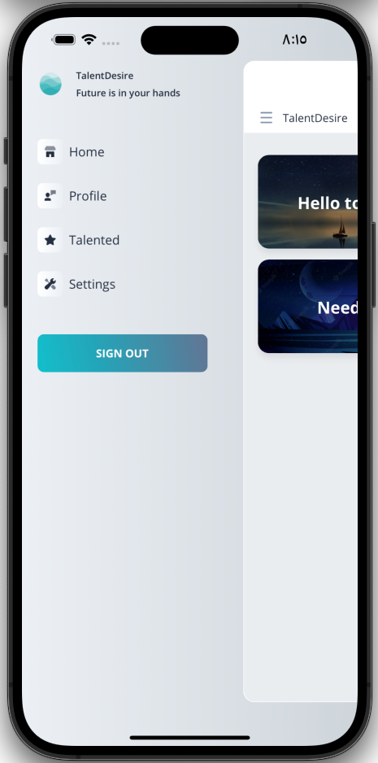
Login & Navbar

Slide 39
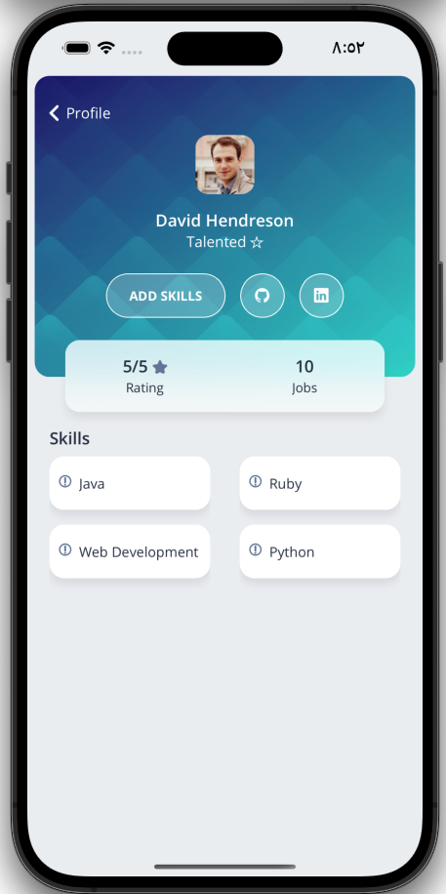
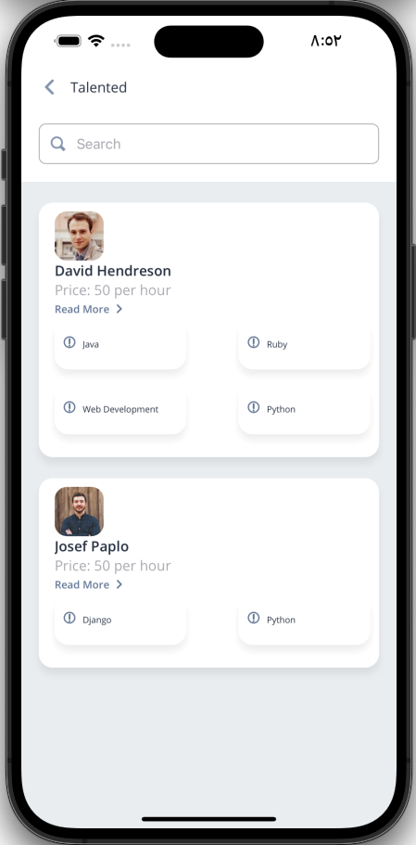
Profile & Talented members

Slide 40
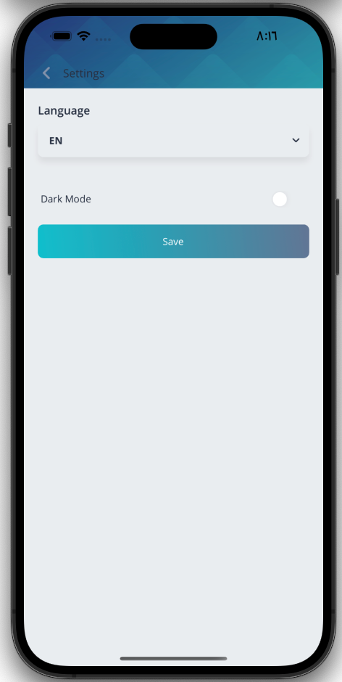
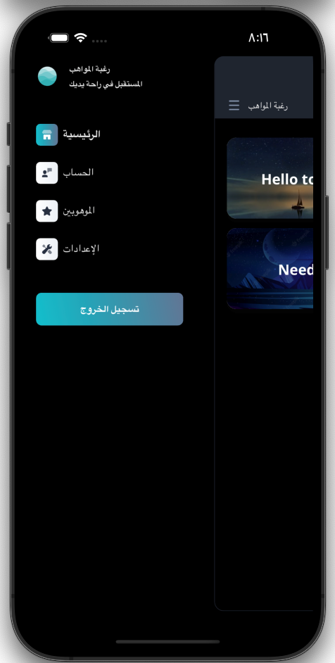
Settings & Dark UI

Slide 41
Our Conclusion

Slide 42
Thanks!
{
“response”: “Any Questions?”
}
console.log(Object.value(response));

